Slide 1
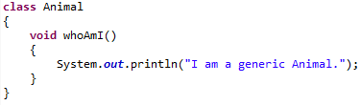
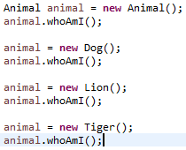
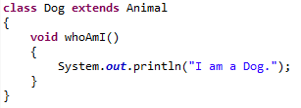
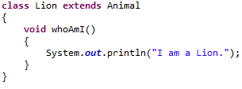
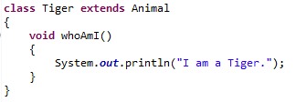
Polymorphism
Polymorphism is the capability of an action or method to do different things based on the object that it is acting upon. In other words, polymorphism allows you define one interface and have multiple implementation. This is one of the basic principles of object oriented programming.
The method overriding is an example of runtime polymorphism. You can have a method in subclass overrides the method in its super classes with the same name and signature. Java virtual machine determines the proper method to call at the runtime, not at the compile time.
In Java, a variable declared type of class A can hold a reference to an object of class A or an object belonging to any subclasses of class A. The program is able to resolve the correct method related to the subclass object at runtime. This is called the runtime polymorphism in Java. This provides the ability to override functionality already available in the class hierarchy tree. At runtime, which version of the method will be invoked is based on the type of actual object stored in that reference variable and not on the type of the reference variable.

